Slide 1
From aptitude to achievement: How’s that going?
For Symposium: University admission testing in Chile: Current controversies and Future Directions
Richard P. Phelps
International Test Commission
19th Congress, June 2018
Montréal, Canada

Slide 2

2 types of standardized tests used for university admission
Achievement
Aptitude
Notes:
Two main types of standardized tests used in the context of university entry
Achievement Aptitude
There is no pure form of either; all achievement tests test some aptitude; all aptitude tests test some achievement

Slide 3

History of the PSU
1966 – 2003:
Prueba de Aptitud Académica (PAA) → based on the USA’s university admission exam, the SAT
Supplemented by content tests (like SAT IIs) for admission in certain specialized careers, such as engineering and medicine
New test (~2000):
Achievement test, based 100% on secondary school curricula
Notes:
The PSU was first proposed around the year 2000. From 1966 to 2003, Chile employed a different system for university admission. The PAA was an aptitude test, modeled on the SAT test in the United States. It was supplemented in some career fields with tests focused on their most relevant curriculum.
The PSU was proposed to be an achievement test—based 100% on the new curriculum proposed for the science-humanities track. Change was made around the same time the U. of California president was arguing for an aptitude to achievement conversion.

Slide 4
Origin of the PSU: Given (too) many purposes
2000, initial proposal: Project SIES→ PSU project
- More efficient and modern, with item response theory (IRT)
- Better articulation between secondary and university education
2001 World Bank loan to Chilean Education Ministry to finance education reform
Align the test with secondary school curriculum
Eventually, use it for secondary school graduation
Notes:
From the start, those promoting and funding the PSU, such as the World Bank, over-promised. Those funding the PSU did not understand testing very well. Much of the early history of the PSU can be found in World Bank documents.
Much of the appeal was to newness – the PAA was old, developed in the 1960s – so, surely, forty years later, one could make a better test.

Slide 5
PSU: given too many purposes 2
2005 (World Bank)
- Linking financial aid to scores PSU will favor the access of low-income sectors to the university
2009 (OECD & World Bank)
Evaluate “capacity to reason” and “learning potential,” add written essay and “non cognitive” testing
2010 (World Bank)
- Replace entry test with single exit exam for all secondary education
- Curriculum-based test will motivate students to study more
Notes:
Some of the promises made little sense. Some made no sense in the context of other promises; they were contradictory.
Proponents appealed to economic rationales, e.g. efficiency of a single exam; incentives in a curriculum-based exam. Economists are all about incentives.
Without an expertise in test development, funders made conflicting recommendations.

Slide 6
Multiplity of promises for the PSU:
Monitor the implementation of a new curriculum;
Measure the mastery of two very different curricula;
Incentivize secondary schools to implement the new curriculum;
Incentivize students to study more;
Predict success in university generally;
Predict success in very different university programs;
Set cut scores for university admission, scholarships, and financial aid.
Notes:
Multiplicity of purposes expressed for the PSU (these are only some of them)
Measure the implementation of a new curriculum;
Measure mastery of two different curricula;
Incentivize high schools to implement the new curriculum because it would be tested;
Incentivize high school students to study more;
Predict success in university generally;
Predict success across very different types of university programs;
Provide cut-scores for university entry, need scholarships, and merit scholarships
No single test can possibly do all of this well.

Slide 7
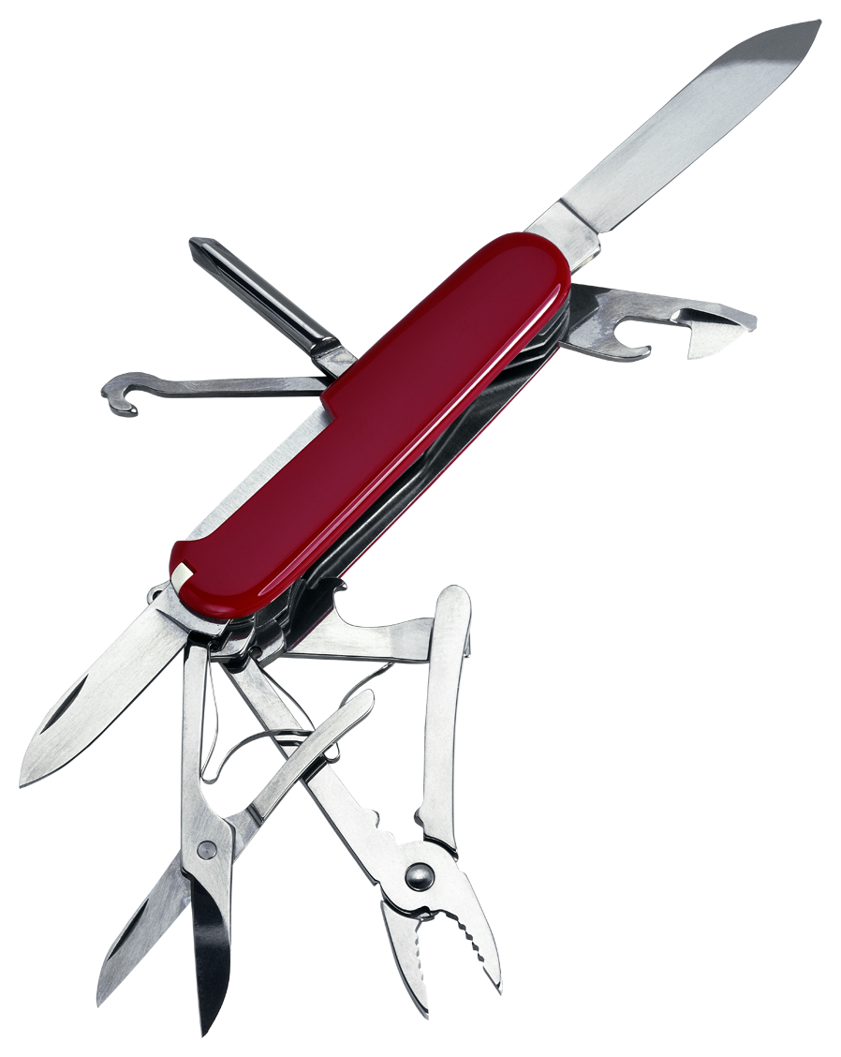
PSU: a test at war with itself
Burdened with too many purposes
... each time another purpose is added to a test, the test becomes a poorer measure for each purpose
Notes:
The PSU: A test at war with itself
Expected to do to many things…
…each time another purpose is added to a test, the test becomes a poorer measure for each purpose

Slide 8
Achievement tests in the context of university entry: How are they validated?
Through alignment with the content taught in secondary school.
Achievement tests are retrospective, aligned with content learned in the past.
Test scores are typically highly correlated with other available student measures, such as grades and class rank.
Achievement tests are typically summative, or exit exams, administered at the end of a program.
Fairness assumes that all students have had the same opportunity to learn the content tested.
Notes:
Achievement tests in the context of university entry
How validated: through alignment with secondary school curriculum; Achievement tests are retrospective – aligned with content learned in the past.
Achievement tests are typically summative, or exit exams, taken at the end of a program.
Highly correlated with other available measures, such as high school grades and rank
Fairness assumes that all students have had the same opportunity to learn content

Slide 9
Aptitude tests for university admission: How are they validated?
Predictive validity: the correlation between test scores and measures of future outcomes, such as university grades
Little emphasis on content:
- Aptitude test content is basic, common knowledge
- Test measures how well students reason and solve problem; what they do with the information provided
Aptitude tests are not easily coachable:
- The content domain is too broad for focused study
Notes:
Aptitude tests in the context of university entry
How validated: predictive validity, correlation with future activity (e.g., university grades)
Content is set at a universally common school level, and much broader
… content used is basic, broad, commonly available, not necessarily school related
… item types can be different – problem solving -- test measures what student does with the content provided
Not easily coachable
…content domain is common knowledge, too broad a domain for focused study

Slide 10
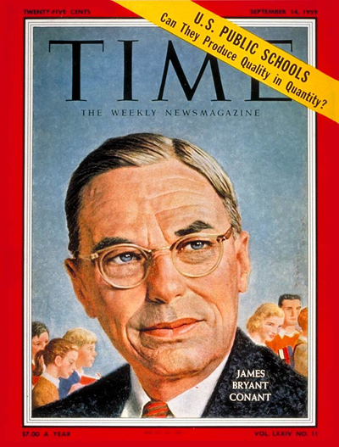
Aptitude tests for university admission – history
Decade of 1930s
President of Harvard, J. Conant …
Wanted test to identify students from low socio-economic class with potential to succeed at Harvard:
“diamonds in the rough”
Developed first Scholastic Aptitude Test (SAT)
Notes:
Aptitude tests for university entry - History
1930s – Harvard University president J. Conant
Disliked content tests that penalized students from lower socio-economic status who had less access to quality education
Wanted new admission test to identify students from lower socio-economic classes with potential to succeed at Harvard – “diamonds in the rough”
Encouraged the development of the first Scholastic Aptitude Test (SAT), adaptation of the U.S. Army test

Slide 11
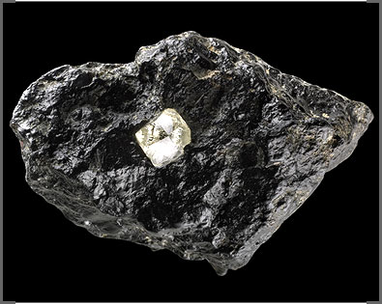
Aptitude tests for university admission
Aptitude tests, well constructed, can identify:
students bored by secondary school courses, who study what interests them on their own
students poorly adapted to secondary school culture, but well adapted to university culture
high-ability students poorly served by poor quality secondary schools
Notes:
[ picture of diamond in the rough ]
Well constructed aptitude tests can identify, for example:
bright students who were bored in secondary school but studied what interested them on their own
students not well adapted to rigid high school culture, but well adapted to the more open university culture
students of high ability held back by poor quality schools

Slide 12

More information is better, usually
If university were just like secondary school, perhaps high-school grades and a retrospective content test would suffice for admission purposes.
But, university is not just more challenging academically, it is very different from secondary school in other respects, too.
Notes:
More information is usually better
If university were just like secondary school, perhaps high-school grades and a retrospective content test would suffice for admission purposes.
But, university is not just more challenging academically, it is very different from secondary school in other respects, too.

Slide 13
If more information is better, we should maximize the information available about a student at university entry, in order to make the best match between the student and the institution
3 measures are important:
1. Predictive validity
2. Sub-group differences
3. Content coverage
Notes:
If more information is better, we should maximize the information available about a student at university entry, in order to make the best match between the student and the institution
Three measures are important to consider:
1. Predictive validity
2. Differences between groups
3. Content coverage

Slide 14
Incremental predictive validity (engineering):
(controlling for secondary school grades)
SOURCE S.A. Prado, Estudio de Validez Predictiva de la PSU y Comparacion con el Sistema PAA, Universidad de Chile
Notes:
A University of Chile student did his doctoral dissertation comparing the predictive validity of the PAA and PSU for engineering departments. He found that the PAA was more predictive, even for engineering, a field for which one would expect a curriculum-based test to be better.

Slide 15
Predictive validity: SAT & PSU
SOURCE: Pearson, Final Report Evaluation of the Chile PSU, January 2013; SAT data from College Board.
Notes:
Comparing predictive validities of the US SAT test to the PSU
In Language, Mathematics, Writing (only SAT), Social Science (only PSU)

Slide 16
SOURCE: N. Lacourly, M. Silva, & K. Diaz, 2016.
Notes:
Now for incremental predictive validity – the single most important measure of a university admission test’s worth. It is the amount of information an admission test provides above and beyond all other factors considered, such as high school grades and ranking.
This is the incremental predictive validity by career for the PSU administered in 2012. Two points are important.
First, the numbers are low. The average incremental predictive validity of the US SAT test is around 8 percent. The PSU approaches 8 percent for only one career – Chemistry and Pharmacy. The PSU average is 2.4 percent.
Second, the variation across careers is large. The PSU is more predictive for technical careers, less so for pure science and engineering degrees, and not at all predictive for some careers, particularly careers for which the curriculum is new and different from secondary school, such as art, architecture, and design.

Slide 17
Drop in the numbers of students from municipal high schools accepted at 4 major universities
SOURCE: Simonsen (2008), Zuñiga (2005), & El Mercurio (April 16th, 2006)
Notes:
This chart traces the percentage enrollment of municipal school graduates at four universities from 2003, the last year the aptitude test was used for admission … to 2008, the fifth year of the new achievement-type admission test. Municipal schools are public schools; they enroll the poorest students, as well as those students least likely to have studied the full Scientific-Humanistic curriculum.

Slide 18
Percentage of Chilean Schools reporting complete curriculum coverage of mathematics and language arts: 2012
Primary and Secondary Levels
SOURCE: Centro de Estudios Mineduc, Cobertura Curricular en Enseñanza Media Lenguaje y Comunicación – Matemática, Septiembre 2012
Notes:
The Chilean Education Ministry conducted a content coverage survey in 2012. Only around a quarter of secondary schools covered the entire curriculum – as was required – in either mathematics or language.

Slide 19
Merci !

